Slide 1
YSN In–Person Meeting Swindon

Slide 2
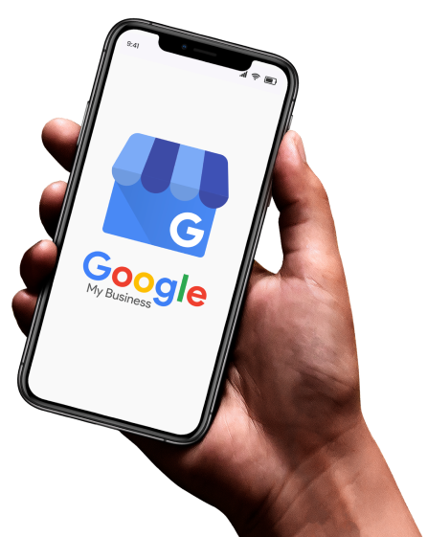
Google My Business Checklist

Slide 3
What percentage of consumers search Google Maps to find a business?
Bright Local Consumer Review Survey

Slide 4
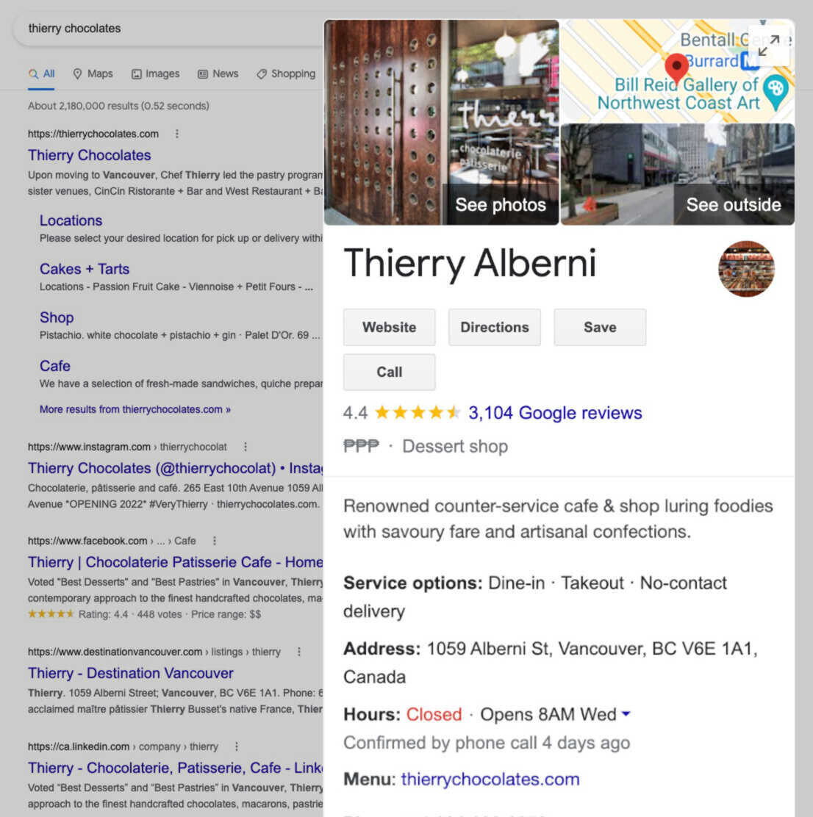
What is Google My Business?
Google My Business Profile is a FREE tool that allows you to influence how your business appears on Google Search, Google Maps and Google Shopping.
Why it matters for Local SEO?
There are many benefits of maintaining a Google Business Profile:
Increased Visibility (Local SEO)
Gain Credibility with Reviews
Drive Traffic
Share Business Info
Free Marketing!

Slide 5
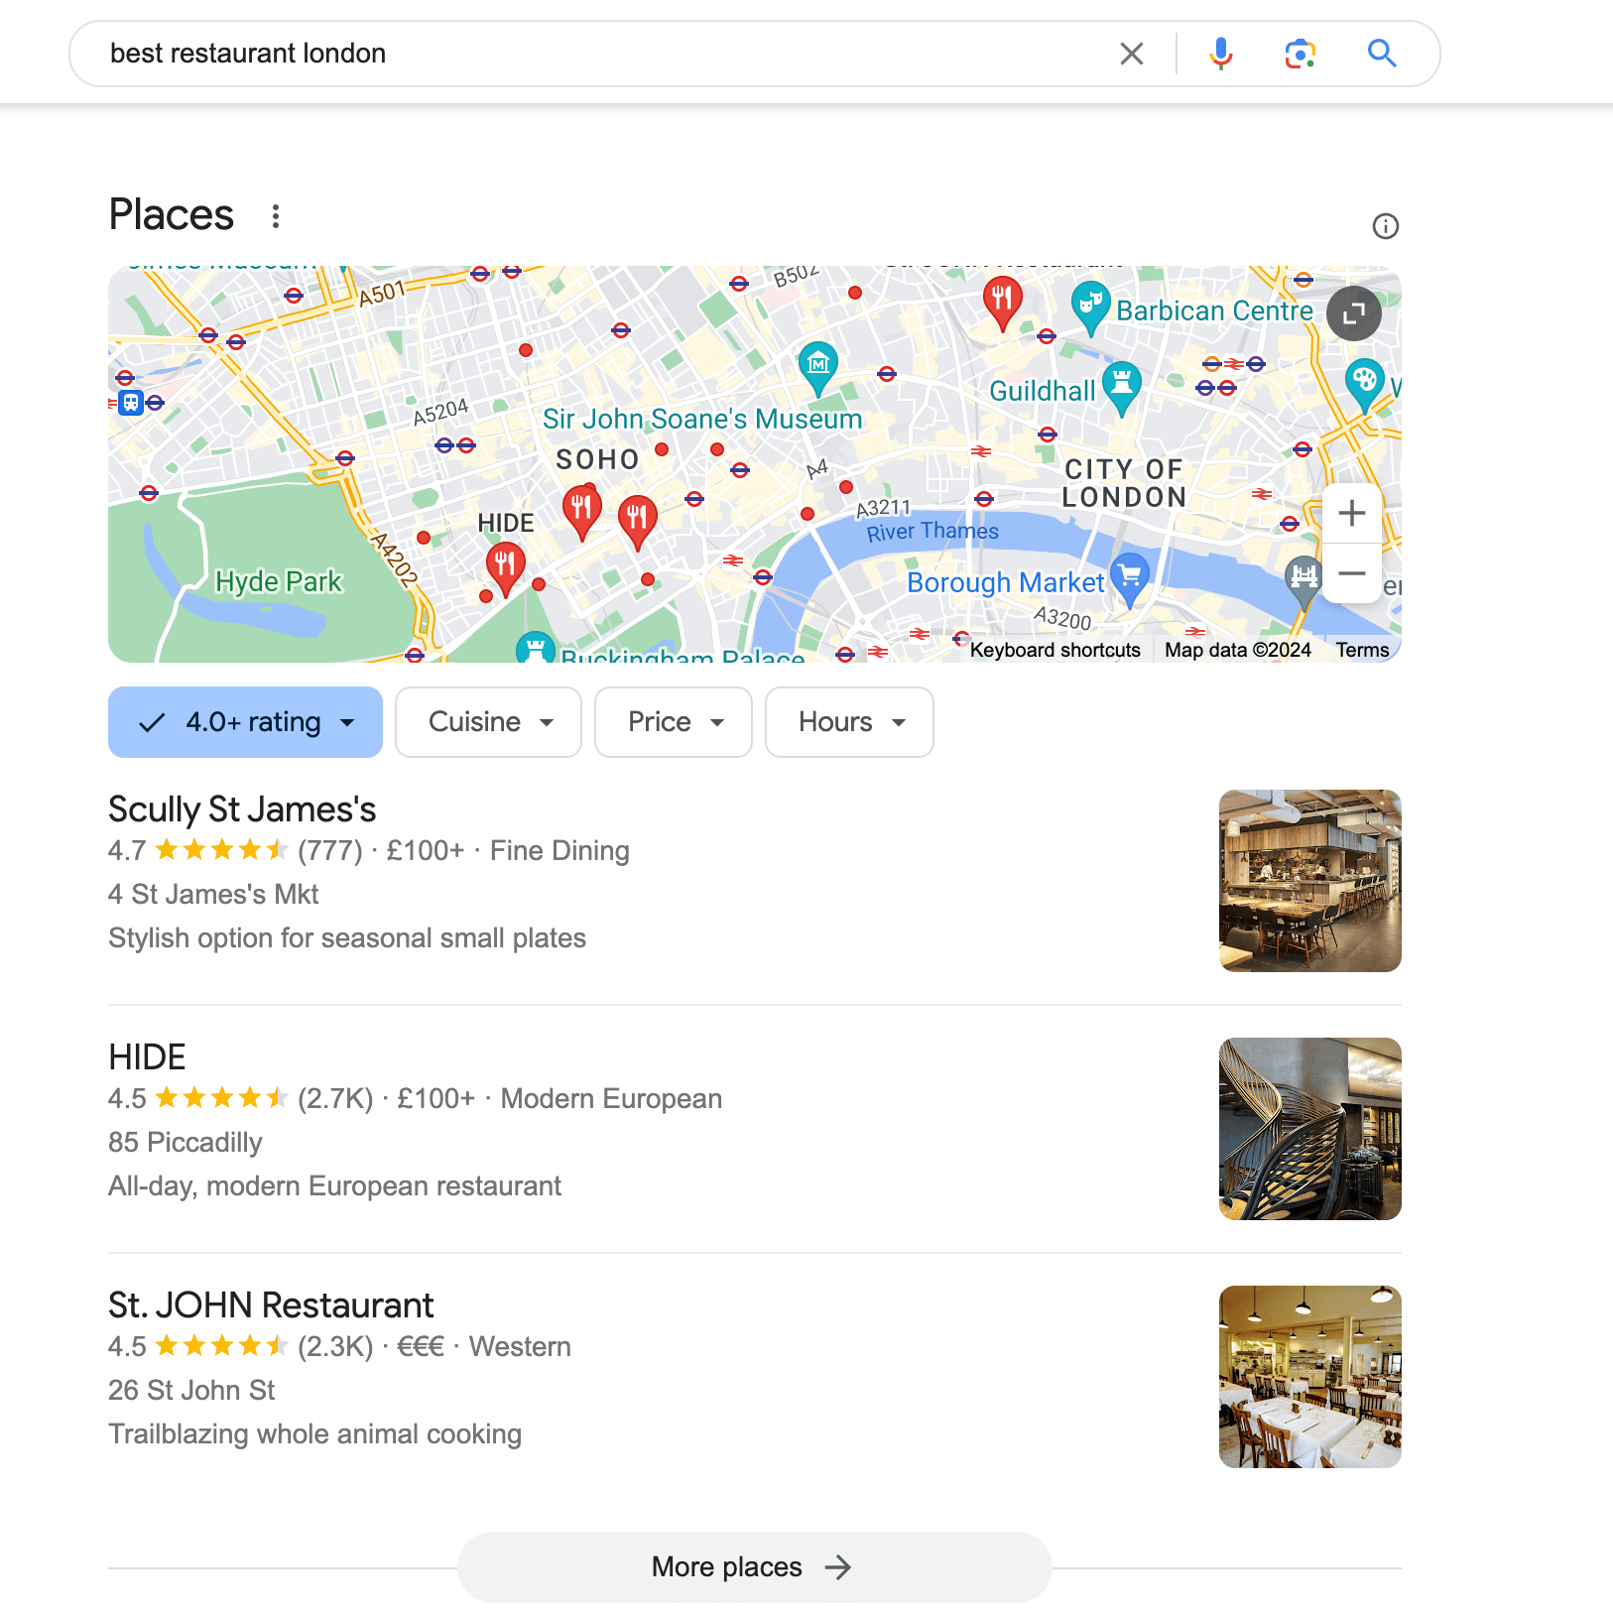
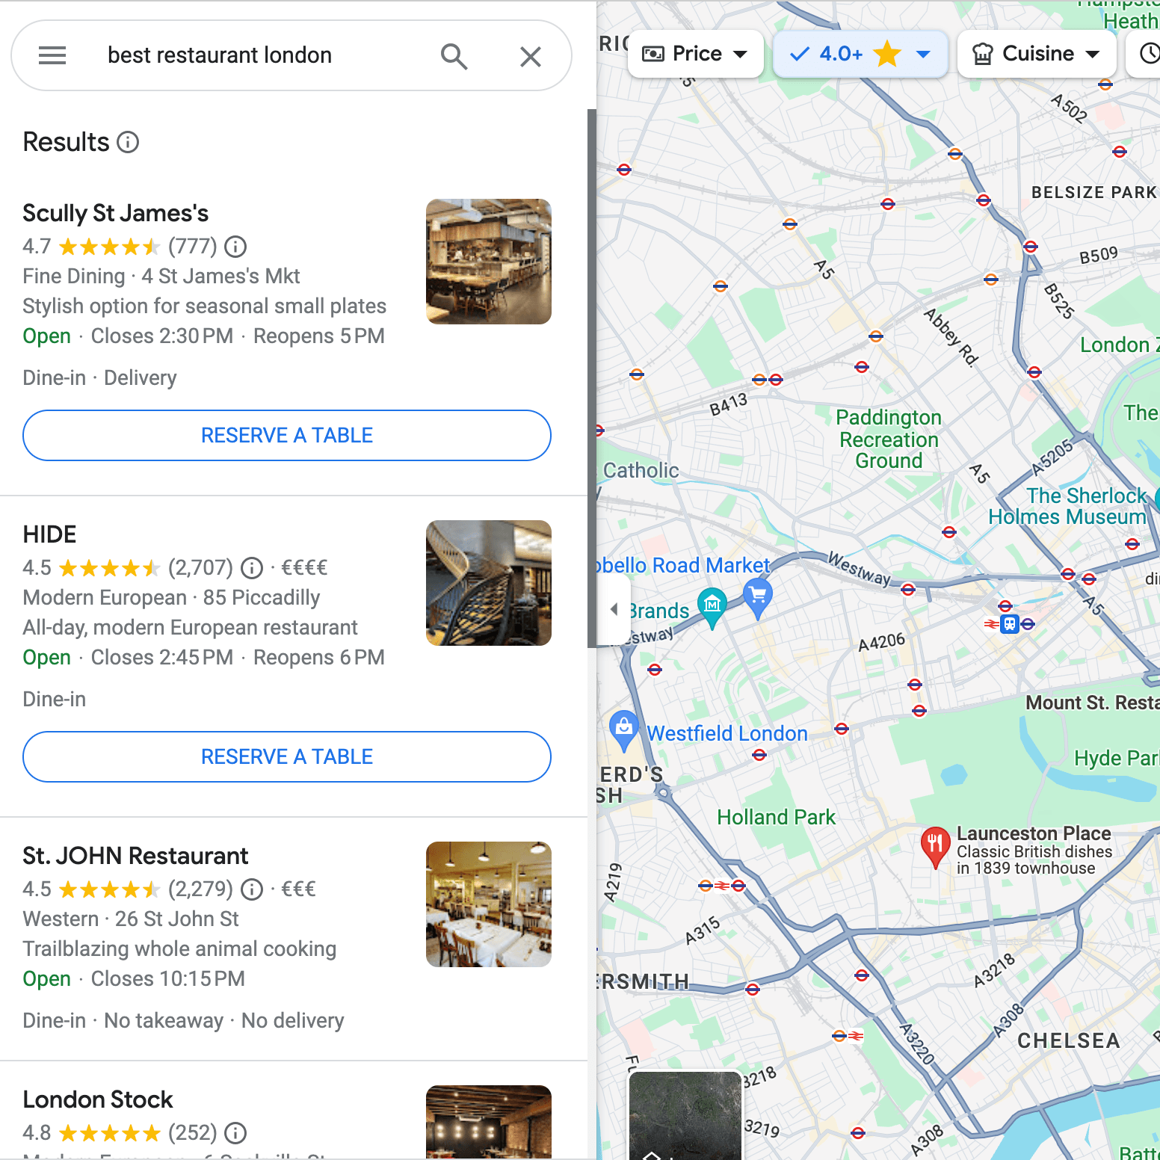
Where is your business listing visible?
The local pack: this is the section of the Google search results page which displays a list of local businesses related to the keyword you entered.
Information sheets: this is the information box that appears in the top right-hand corner of search results.
Google Maps: the listing may appear when a user searches for a business in a specific location or browses a particular geographical area.
Google Search: the listing may appear in natural search results when a specific company or product is searched for.
Example of a search for the “best restaurants” in London on Google Maps.
Example of a local pack for a Google search for the “best restaurants” in London.

Slide 6
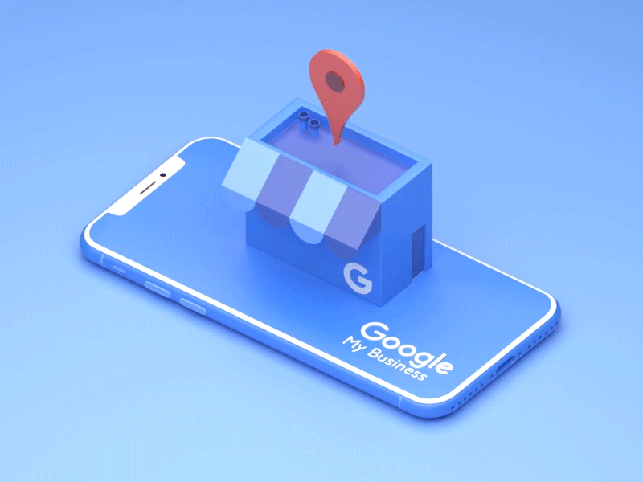
Checklist: Setting up your Google My Business Account
Get the basics right – Name, Business Category, Address/Service Area, Phone Number, Website, Hours
Verify your GMB listing – believe it or not, this was done via a postcard. But now you can do this via email, phone, text, mail, live video call and video recording (there are guidelines)
Include products & services – People need to know what you sell or offer. This is important if your company name doesn’t make it obvious.
Add a ‘From The Business’ – Content that is clear and tells the world who you are. Character limit 750 characters. The first 250 characters will be visible straight away. Include your USP’s & relevant keywords too!

Slide 7
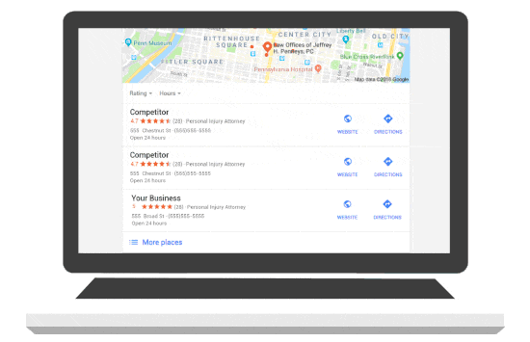
Checklist: Setting up your Google My Business Account
5. Add photos and Images – This helps the customers visualise your products directly.
6. Q&A – These can be owner or user generated. This can be turned off, however the user can post questions for you to answer. Or you can write your own Q&A’s – When answering keep keywords in mind, this can help improve your business rankings for that keyword Google sees.
7. Posts – Just like social media, post regularly, this can be announcements, special offers and more. This is a positive ranking, similar to images, shows Google you’re active and can boost your local visibility.
8. Messaging – Enable direct messaging so your customers can LIVE CHAT with you through your GMB listing.

Slide 8
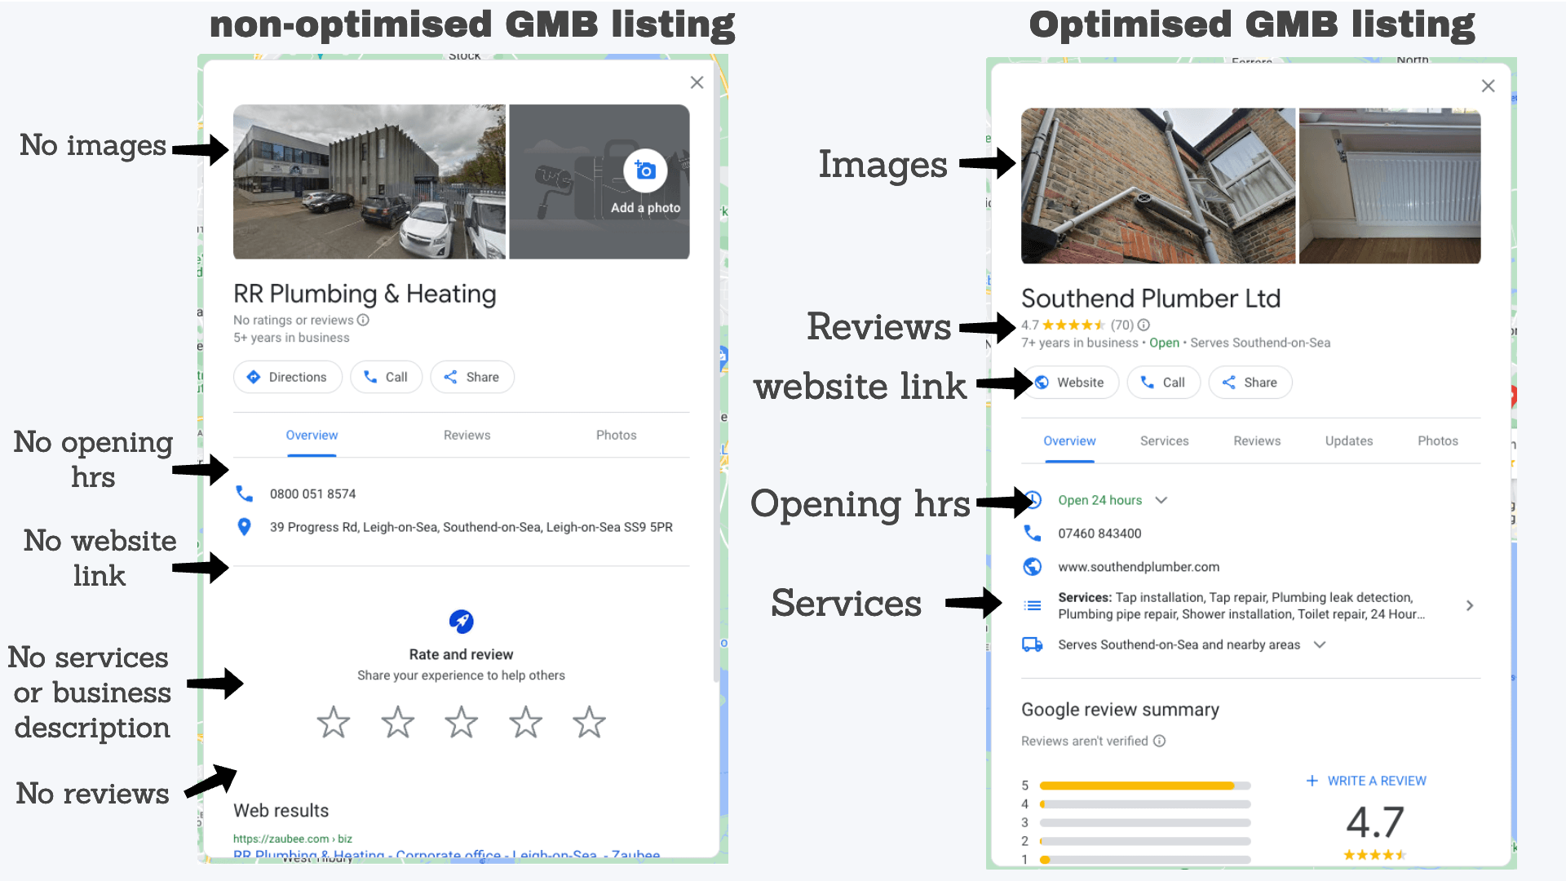
Google My Business Checklist

Slide 9
What percentage of people read Google My Business reviews before contacted a local business?
Bright Local Consumer Review Survey

Slide 10
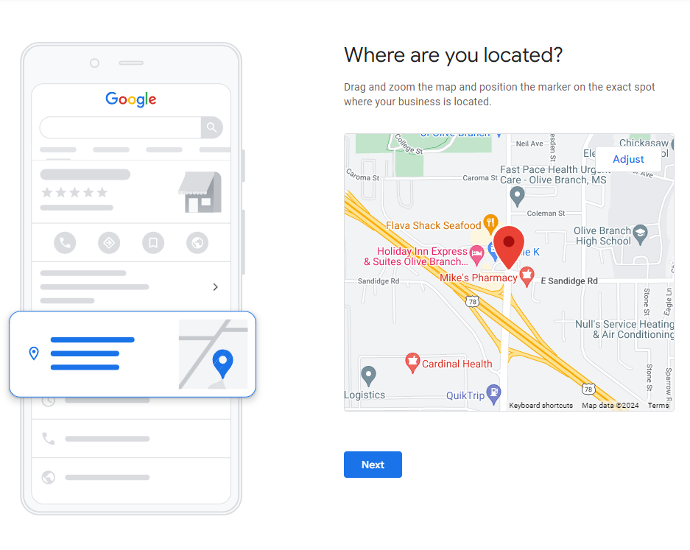
Checklist: Optimising your Google My Business Profile
Regularly Add Photos and Videos
Encourage and Respond to Customer Reviews
Post Regular Updates
Leverage Keywords in Your Profile
Add Accurate Business Information
Use GMB Messaging
Utilise the Q&A Section
List Your Business on Online Directories & Citations
Regularly Update Business Attributes
Maintain Consistency Across All Platforms

Slide 11
Major Google My Business Ranking Factors
Relevance
How well your Google My Business listing matches the search query. Ensure your business description, services, and categories align with the terms your customers are searching for.
Proximity
The physical distance between the searcher and your business. The closer your business is to the user’s location, the more likely it will appear in local search results.
Prominence
The overall online visibility and reputation of your business. Factors like website authority, links, and reviews all contribute to how prominent your business appears.
Reviews
Both the number and quality of reviews affect rankings. Businesses with higher ratings and more frequent reviews tend to rank better in local searches.
Engagement
The level of interaction your listing receives, including clicks, calls, driving direction requests, and message responses, plays a role in how Google perceives your business’s relevance and importance.
Category Optimisation
Choosing the most accurate and specific business category helps Google match your business with relevant local search queries. Be as precise as possible to avoid irrelevant searches.
Citations and Backlinks
Citations (mentions of your business on other websites) and backlinks (links to your website) from reputable sources improve your GMB listing's authority and ranking.

Slide 12
“Where to buy” & “near me” mobile queries have grown by over 200% in the past two years.”
Google My Business is the most important ranking factor for local SEO.​
Google My Business is the most common way for customers to find local services, with 7 out of 10 consumers using it
Google’s Consumer Insights

Slide 13
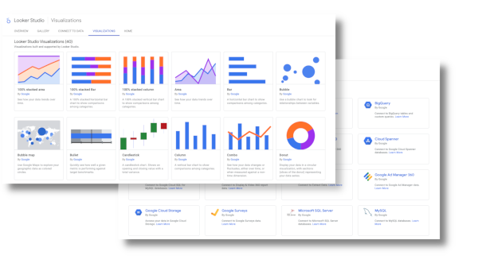
Looker Studio – Diving deeper Into data

Slide 14
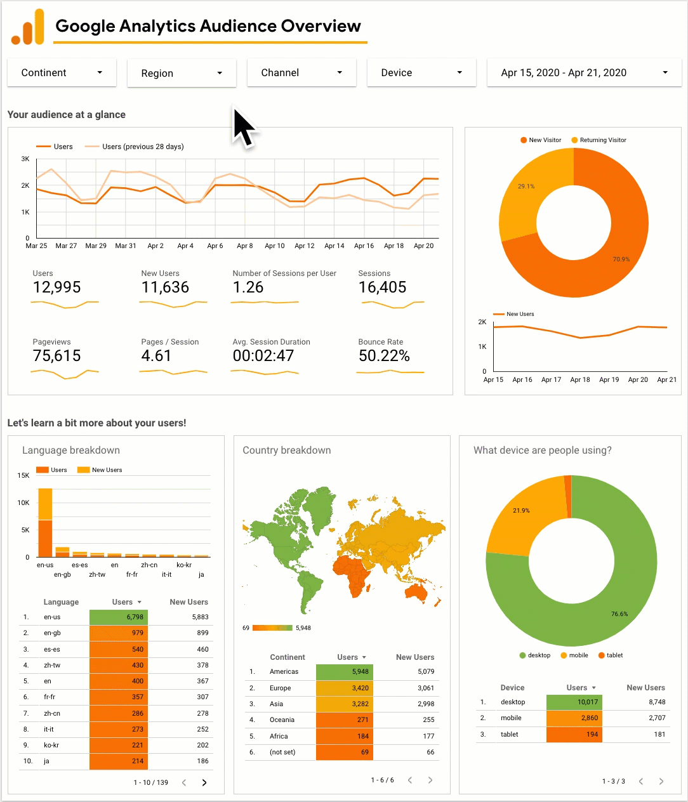
What is Looker Studio?
Looker Studio is a FREE data visualisation tool that allows you to import data from multiple sources and visualize them on a report that is easy to read and share. You can import data from any source using Google Sheets or Data Connectors to create the report you want.
Why Looker Studio?
Looker Studio has the capability to make your data into the most attractive and easy to read format, that can be effortlessly digested by for you .

Slide 15
Benefits:
You can create comprehensible and understandable reports
Pull data from multiple sources – a single report can use data from two or more sources
Create dynamic reports – easy to refresh data
Create fully customisable reports – drag & drop
You can get updates in real time
You can create unlimited reports
Best thing... It's FREE!

Slide 16
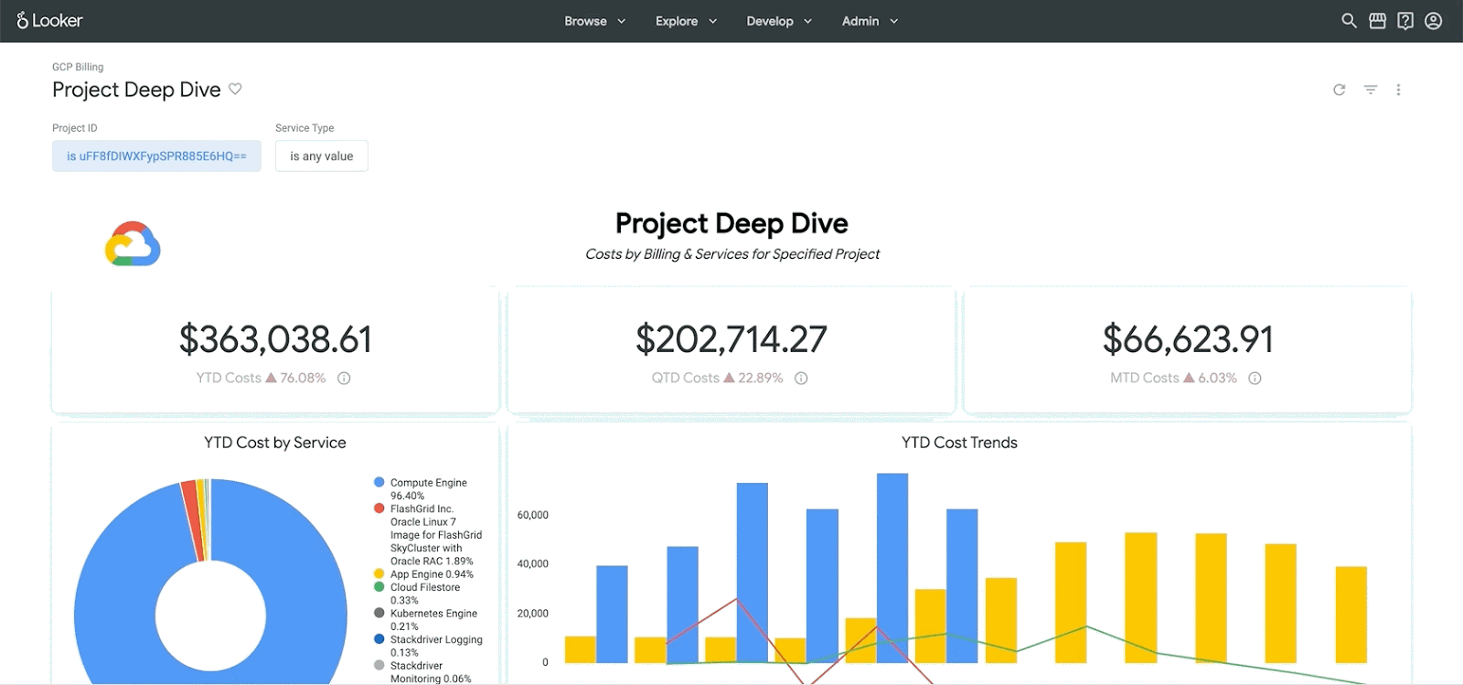
Over 50 + Visualisation tools

Slide 17
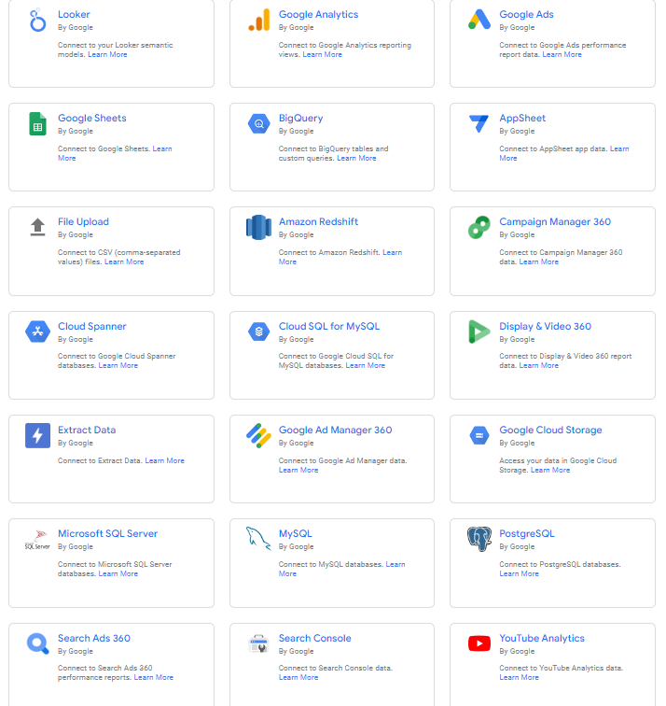
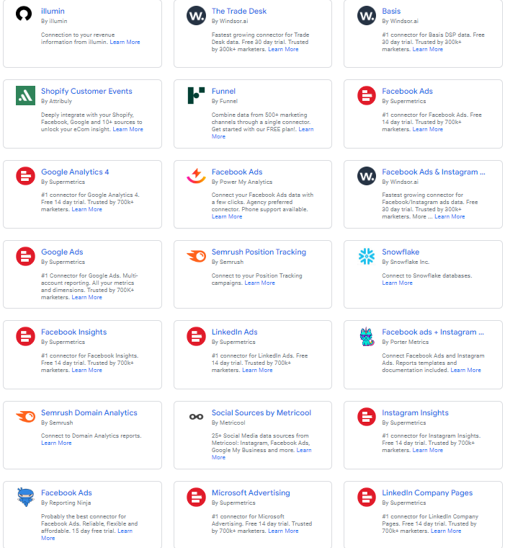
1000+ data sets from over 1050 connectors.

Slide 18
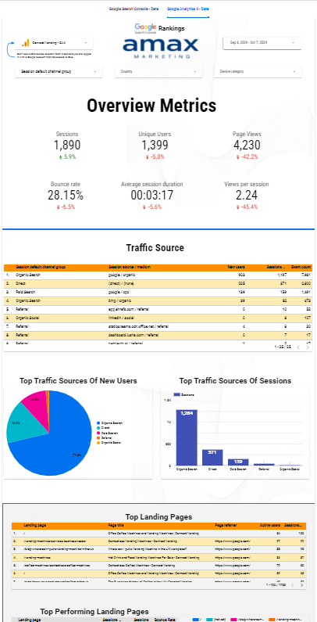
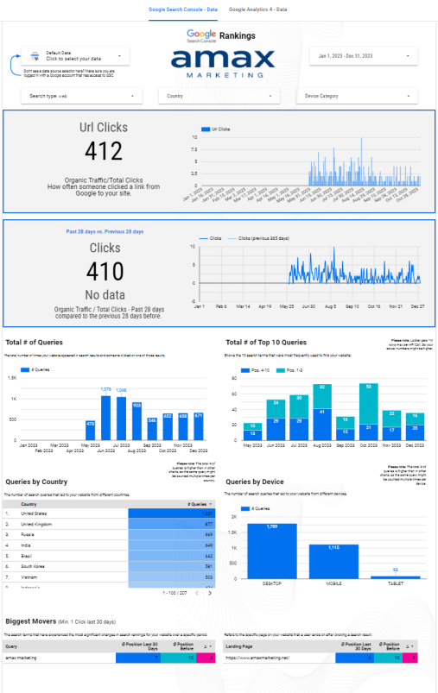
For you today...
We have just launched a dashboard...
And It's FREE!
To access this, all you have to do is:
Scan the QR code on the next slide
Follow this form
Add in the details
We share this with you!

Slide 19
Make sure you use the email address you used to set up GA & GSC!

Slide 20
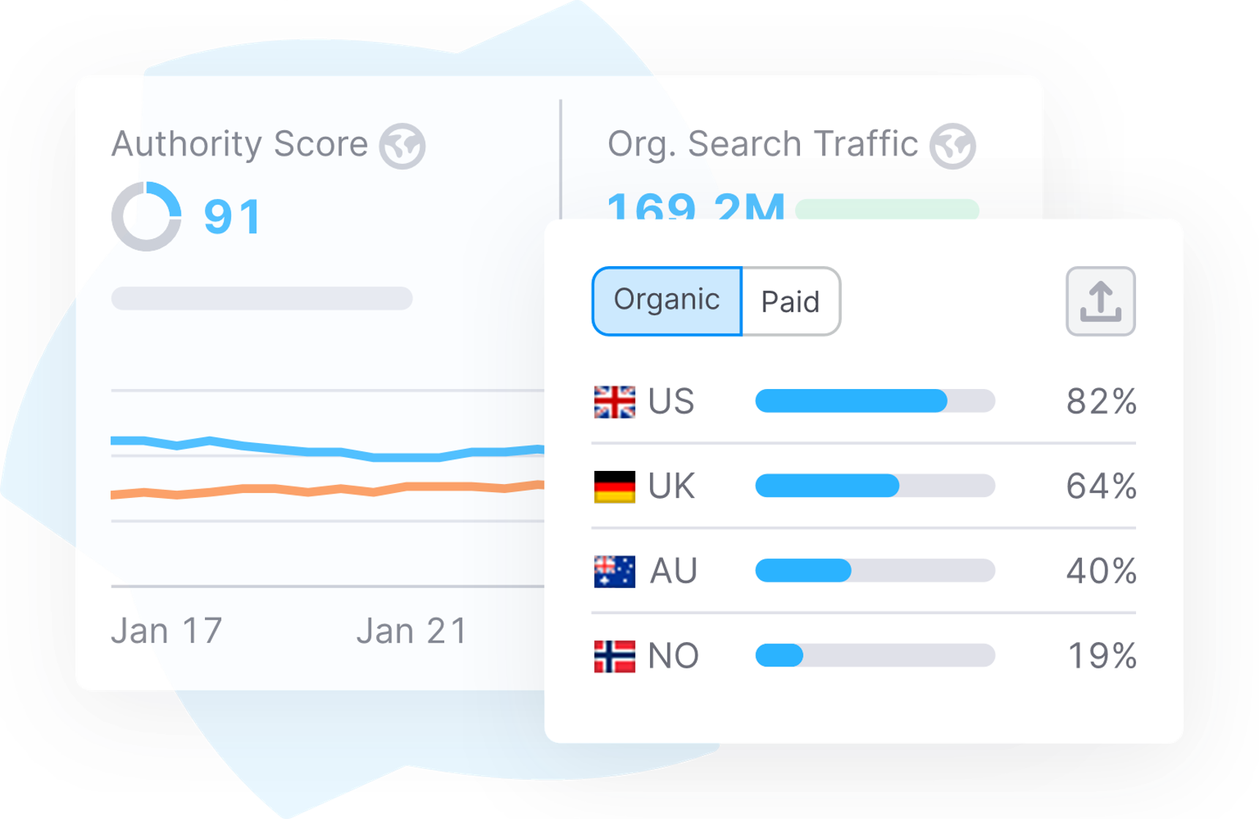
SEO – Where are you at?

Slide 21
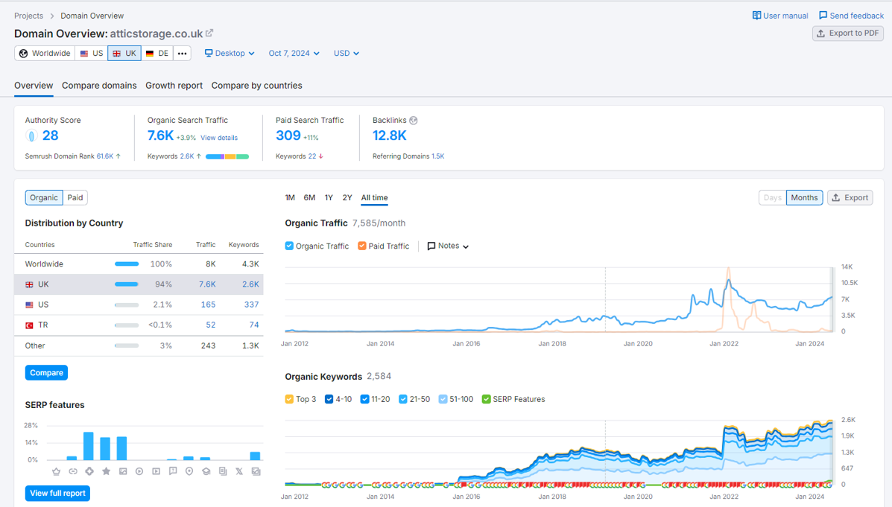
Let's look at your data...Overview!
Paid Search Traffic ​
The number of visitors to a website that come from paid advertisements, such as Google Ads or other paid digital marketing campaigns.
Organic Search Traffic ​
An estimated count of visits to a website from unpaid sources, such as search engines like Google, Yahoo, or Bing.
Backlinks ​
A tool that helps users find and build backlinks for their website. Backlinks are links from other websites that point back to a page on your website.
Authority Score ​
This is a score that’s calculated based on website's referring domains, backlinks, organic traffic, keywords and more.

Slide 22
Let's look at your data...Top Keywords !

Slide 23
Let's look at your data...Top Keywords !
Dedicated landing Pages
Keywords – The keyword people search for.
Position – Where you're placed on Google Search
Volume - the average number of times a specific search query is entered on a search engine per month.
KD% - a metric that tells you how much SEO effort it might take to organically rank a page in the top 10 results on Google for a certain keyword URL - the keywords that bring users to a URL through Google's top 100 organic search results
Intent -
Navigational intent: Users want to find a specific page (e.g., “self storage calculator”)
Informational intent: Users want to learn more about something (e.g., “what size storage do I need?”)
Commercial intent: Users want to do research before making a purchase decision (e.g., “self storage in swindon”)
Transactional intent: Users want to complete a specific action, usually a purchase (e.g., “storage units to rent”)

Slide 24
Thank you very much!
Any questions?

